Slide 1



VALIDATION BEST PRACTICES
Sherri Schreiner & Alex Posey

Slide 2
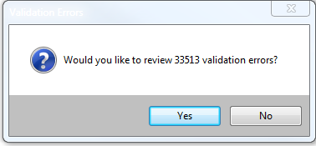

Slide 3
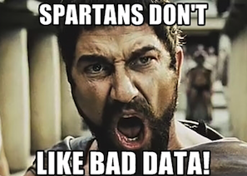

Slide 4
INTRODUCTION
Why are Validation Tasks important
Scheduled Validation Task
Suggested Validation Task
How to find results
Sorting & Exempting Validation Errors
Validation Profiles
What’s New in 3.3

Slide 5
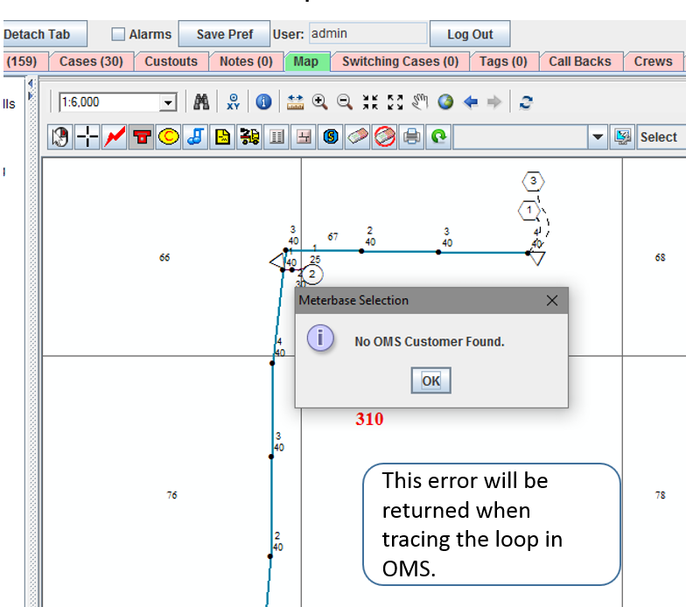
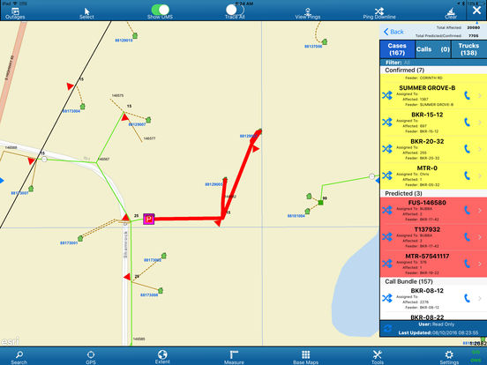
How Validations Can Improve Your Data

Slide 6
Futura Validations
The Importance of Validations
Clean Data and Accurate records
Mismatched phasing will cause tracing to stop.
Missing information will force the staker to populate information before they can complete the job.
Loops will cause tracing issue and data downstream from the loop can not be identified in OMS.
It will also cause Field Pro to crash.
Loops also will create incomplete Futura exports
Disconnected features will also affect the prediction engine and cause unexpected behavior in switching cases in OMS.

Slide 7
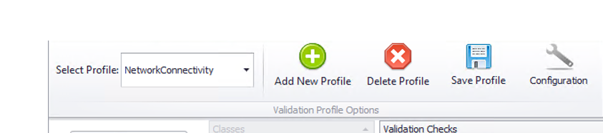
Scheduled Tasks
Scheduled
Network Connectivity Profile – Runs Nightly through Server Utility
Validates feature classes in the Electrical Network dataset.
Validation checks include bank & asset, disconnected, loops, invalid primary neutral, mandatory values, null geometry, phasing, secondary fed from primary, and unique values.

Slide 8
Validation Profiles
Tasks
Electric Other
Non Network
Tables
Other
Selected/Map Extent
Recommended that these profiles run at least once a month.
Custom Profiles

Slide 9
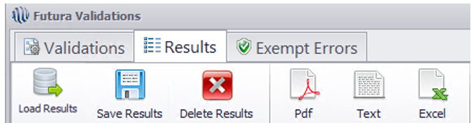
Results
They are stored in the Futura_ValidationResults table in the database.
They can be emailed from Server Utility and the error message with the number of results will appear when the database is opened.
The results can always be seen later by going to the validation tool in your tool bar.
Click Load Results from the Results Tab which are results from the last unattended task.

Slide 10
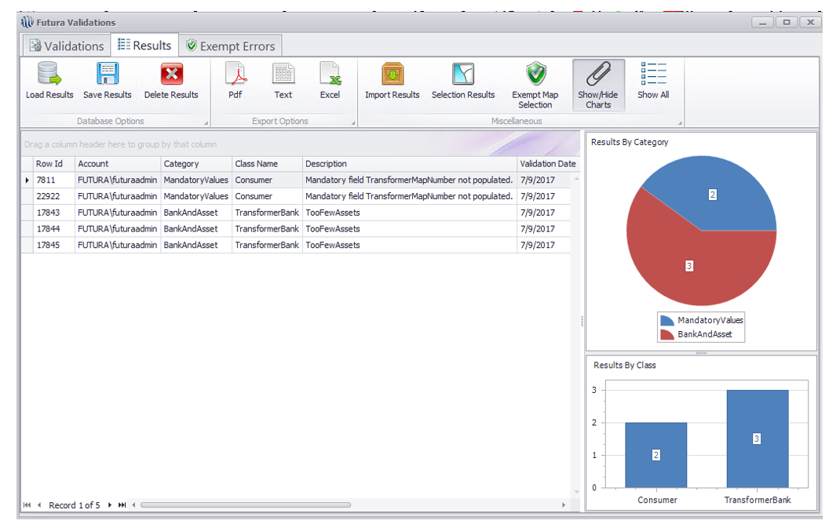
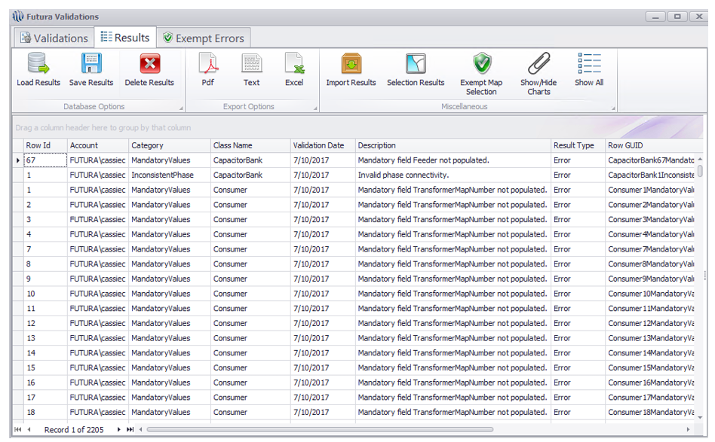
Example of Results

Slide 11
Sorting Results and Exempting
Grouping results by ClassName and Description is helpful when reviewing a large number of errors.
If an error is valid, it can be exempted to avoid seeing the error every time validation runs. We recommend purging exemptions twice a year.

Slide 12
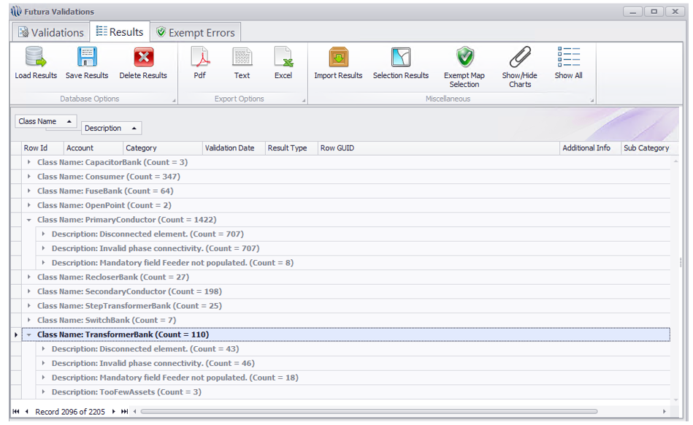
Sorting Example

Slide 13
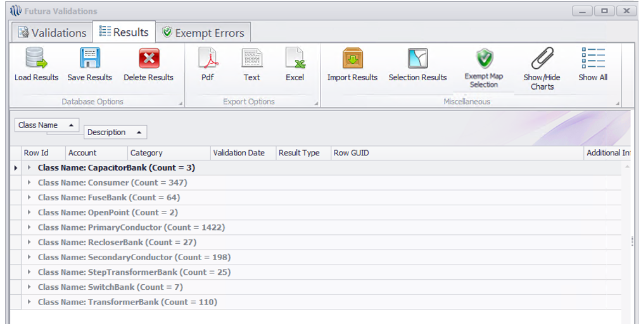
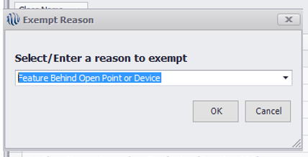
Exempt Errors

Slide 14
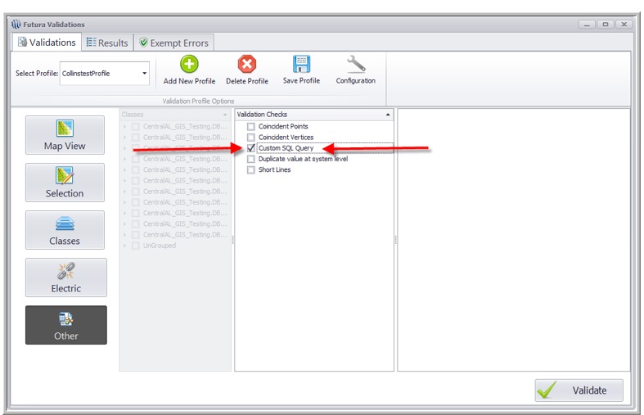
What's New in 3.3 Validations
Coincident Vertices
Custom SQL Query

Slide 15
Coincident Vertices
Returns lines with vertices that are within a specified tolerance
Having coincident vertices negatively affect the electric network and should be removed
Recommend .1 tolerance setting for Primary and Secondary(Same as coincident points)
Previously found using ESRI methods

Slide 16
Custom SQL QUERY
Enhanced ability to automate and customize detailed QC checks
Results written to same results schema as all other standard checks. However we have the ability to customize what we see in the grouping fields
Contact support to help with new queries
Lets take a look at some standard templates
Must be connected to SDE Data
Queries are built in SQL Language
Must have knowledge of SQL to build custom queries
Standard templates are available

Slide 17
Custom SQL QUERY Templates
Included in the new release are several stock SQL templates
These checks can be used as built or modified to fit client needs
Packaged Templates….. Identify banks more than specified distance from related structure, finding orphaned assets, Transformer assets not coincident with related structure, Find Construction units that exist in data but not in the Construction Unit Library, Find OH transformers not related to OH Structures…….This list will continue to grow

Slide 18
Creating new SQL profiles
Custom Profiles can be created quickly and easily using the query builder
Can be as simple or as complex as the end user SQL knowledge
Use existing templates as a starting point
Can you think of any SQL checks that would improve your GIS database QC?
We will gladly help you generate custom queries as we roll out the enhanced Futura validation suite

Slide 19
SQL EDITOR

Slide 20
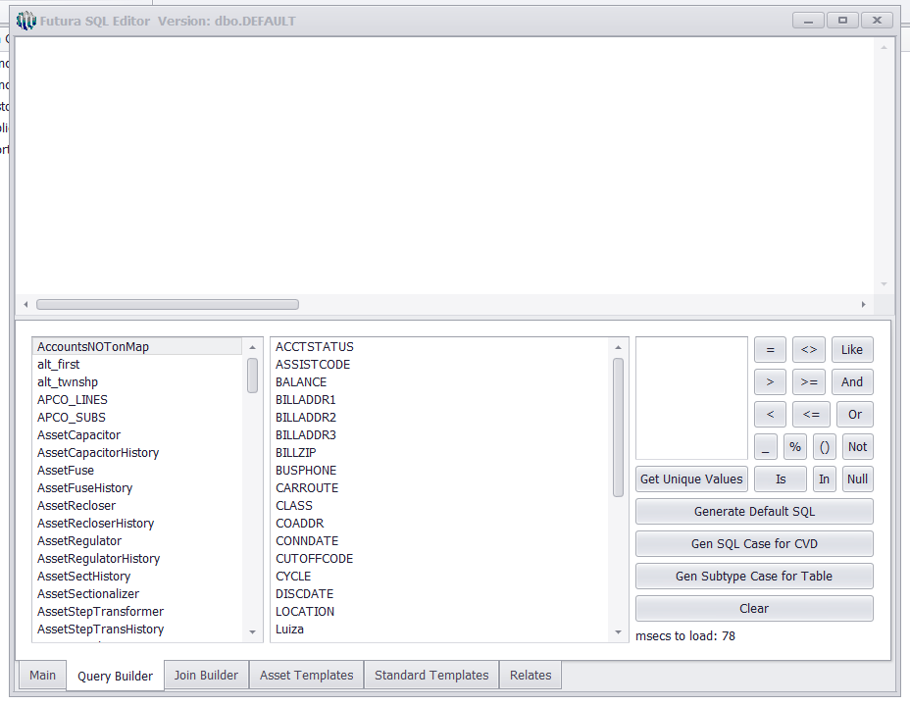
Query Builder

Slide 21
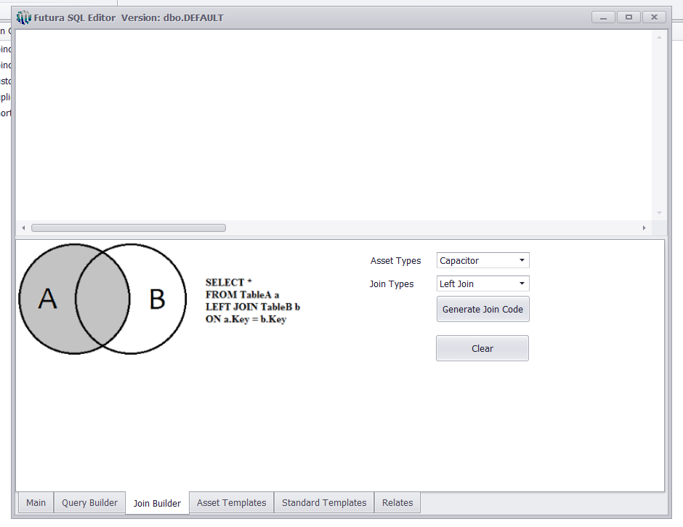
Join Builder

Slide 22
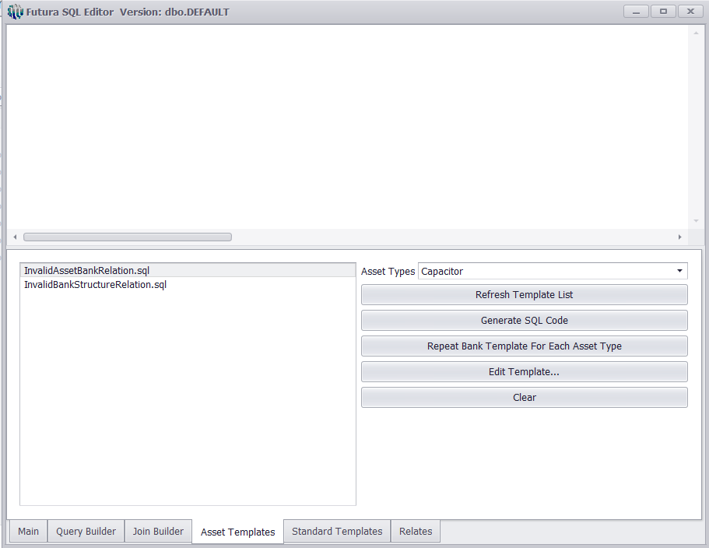
Asset Templates

Slide 23
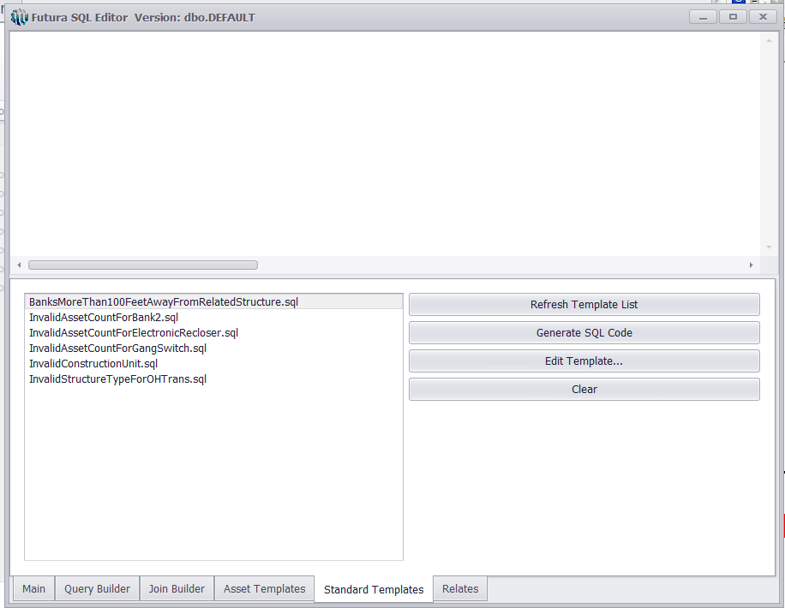
Standard Templates

Slide 24
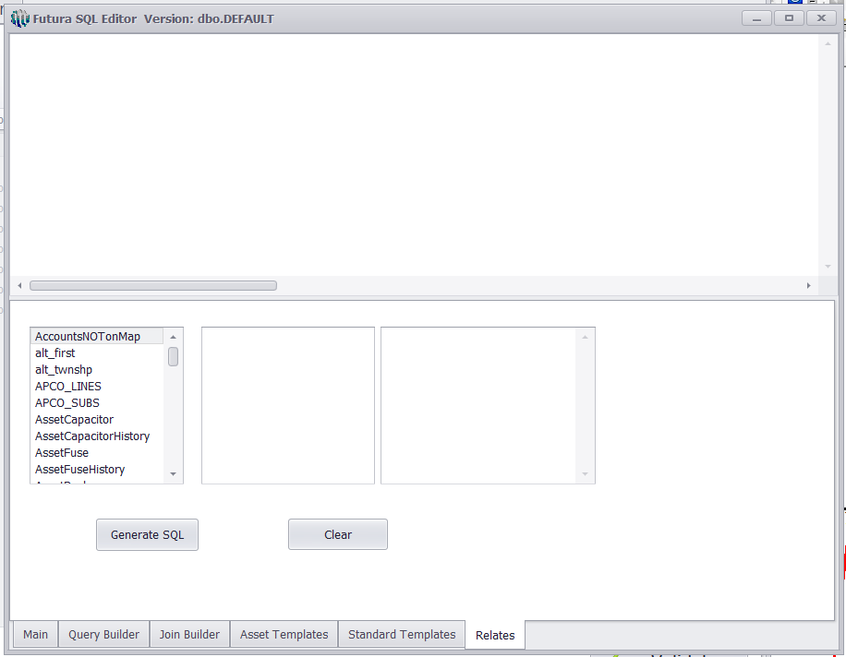
Relates

Slide 25
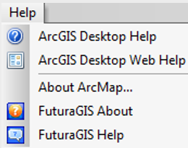
Resources
Help?
Questions???
Futura Client Protal- Futuragis.com
Help Docs → Futura GIS → Electrical Validation Tool
Futura GIS help

Slide 26
Thank you and Game on!

